Slide 1
Connectionist Computing
COMP 30230/41390
Gianluca Pollastri
office: CASL, ground floor Science East.
email: gianluca.pollastri@ucd.ie
Connectionist Computing COMP 30230

Slide 2



Credits
Geoffrey Hinton, University of Toronto.
  borrowed some of his slides for “Neural Networks” and “Computation in Neural Networks” courses.
Ronan Reilly, NUI Maynooth.
  slides from his CS4018.
Paolo Frasconi, University of Florence.
  slides from tutorial on Machine Learning for structured domains.
Connectionist Computing COMP 30230

Slide 3
Lecture notes on Moodle
https://csmoodle.ucd.ie/moodle/course/view.php?id=288
Strictly confidential...
Enrolment key: 30230cc
Connectionist Computing COMP 30230

Slide 4
Books
No book covers large fractions of this course.
Parts of chapters 4, 6, (7), 13 of Tom Mitchell’s “Machine Learning”
Parts of chapter V of Mackay’s “Information Theory, Inference, and Learning Algorithms”, available online at:
http://www.inference.phy.cam.ac.uk/mackay/itprnn/book.html
Chapter 20 of Russell and Norvig’s “Artificial Intelligence: A Modern Approach”, also available at:
http://aima.cs.berkeley.edu/newchap20.pdf
More materials later..
Connectionist Computing COMP 30230

Slide 5
Marking
3 landmark papers to read, and submit a 10-line summary on Moodle about: each worth 6.67%
a small connectionist tool to build and play with: 30%
Final exam: 50%
Connectionist Computing COMP 30230

Slide 6
Programming assignment
Implement a Multi-Layer Perceptron, test it.
The description on Moodle.
Submit through Moodle code and test results by April the 28th at 23:59, any time zone of your choice (Baker Island?).
30% of the overall mark
One third of a grade down every day late, that is: if you deserve an A and you’re 1 day late you get an A-, 2 days late a B+, etc.
Connectionist Computing COMP 30230

Slide 7
Assignment 3
Read the paper “Reducing the Dimensionality of Data with Neural Networks”, by Hinton and Salakhutdinov (2006).
Don’t panic!
The paper is on Moodle.
Submit through Moodle a 400 word MAX summary by April 18th at 23:59, any time zone of your choice (Baker Island?).
6.67% of the overall mark.
One third of a grade down every day late, that is: if you deserve an A and you’re 1 day late you get an A-, 2 days late a B+, etc.
Connectionist Computing COMP 30230

Slide 8
Using backprop for unsupervised learning
Try to make the output be the same as the input in a network with a central bottleneck.
The activities of the hidden units in the bottleneck form an efficient code. The bottleneck does not have room for redundant features.
Good for extracting independent features
output vector
code
input vector
Connectionist Computing COMP 30230

Slide 9
Self-supervised backprop in a linear network
If the hidden and output layers are linear, it will learn hidden units that are a linear function of the data and minimise the squared reconstruction error.
This is exactly what Principal Component Analysis does.
The M hidden units will span the same space as the first M principal components found by PCA
Connectionist Computing COMP 30230

Slide 10
Self-supervised backprop in the non-linear case
If we force the hidden unit whose weight vector is closest to the input vector to have an activity of 1 and the rest to have activities of 0, we get clustering.
The weight vector of each hidden unit (HU->output) represents the centre of a cluster.
Input vectors are reconstructed as the nearest cluster centre.
Number of clusters = number of HU.
reconstruction
data
Connectionist Computing COMP 30230

Slide 11
Models
So far we made models of phenomena.
Our models, in general, were highly complex hypotheses based on the data, and on some parameters, or weights.
So, it is M=M(W).
Can we make the case that we’ve been picking the most plausible models given the data we observed?
Connectionist Computing COMP 30230

Slide 12
plausibility properties
if f(X|I)>f(Y|I), f(Y|I)>f(Z|I), then f(X|I)>f(Z|I)
f(X|I) = F[ f(¬X|I) ]
f(X,Y|I) = G[ f(X|I), f(Y|X,I) ]
Connectionist Computing COMP 30230

Slide 13
we know f
Given the properties above, it is always possible to map f() into the [0,1] interval.
Once we mapped f(), it turns out that F[] and G[] are defined:
F[x] = 1-x
G[x,y] = xy
Let’s call this thing probability
Connectionist Computing COMP 30230

Slide 14
probability properties
if P(X|I)>P(Y|I), P(Y|I)>P(Z|I), then P(X|I)>P(Z|I)
P(X|I) = 1 - P(¬X|I)
P(X,Y|I) = P(X|I)P(Y|X,I)
Connectionist Computing COMP 30230

Slide 15
Bayes’ rule
Since it’s obvious that it must be P(X,Y|I) = P(Y,X|I), we can expand the third rule:
P(X|Y,I) = P(Y|X,I)P(X|I)/P(Y|I)
this is known as Bayes’ rule
P(X|I) is called prior probability
P(X|Y,I) is called posterior
Bayes’ rule tells us how to update our belief in X after we’ve observed Y.
Connectionist Computing COMP 30230

Slide 16
Models, data and Bayes
Let’s now assume that we want to gauge the probability of a model M=M(w) given the data D we have observed.
We can rewrite Bayes rule (I is implied) as:
P(M|D) = P(D|M)P(M)/P(D)
Connectionist Computing COMP 30230

Slide 17
Prior, posterior, likelihood
P(M) is our estimate that model M is correct before seeing D.
P(M|D) is our estimate that M is correct after having looked at D.
P(D|M) is generally called likelihood.
Connectionist Computing COMP 30230

Slide 18
Posterior as next prior
If we aquire data serially, as D1, D2, .. Dn, then we can rewrite Bayes as:
P(M| Dn, Dn-1, .. D1) = P(M| Dn-1, .. D1) P(Dn|M, Dn-1, .. D1) /P(Dn | Dn-1, .. D1)
Our posterior at step n-1 becomes prior for step n.
Connectionist Computing COMP 30230

Slide 19
taking the logs
Probabilities can be small. And often we rather deal with sums than multiplications.
Taking the logs of Bayes’ rule:
logP(M|D) = log P(D|M) + log P(M) – log P(D)
Connectionist Computing COMP 30230

Slide 20
Priors: P(M)
The use of priors is often criticised because it might introduce an arbitrary element into the inference mechanism.
In reality:
  Often, the more data we have, the less important priors become.
  Non-informative priors (e.g. uniform) can often be derived.
  Priors are really always used, even when they aren’t mentioned, so it is better to deal with them explicitly.
  In the Bayesian framework we can at least assess their impact.
Connectionist Computing COMP 30230

Slide 21
Likelihood: P(D|M)
This can be dealt with easily if our model can assess naturally the probability of an observation D (e.g. if the outputs of a softmax MLP could be interpreted as probabilities..), or generates data with a certain probability (think of Boltzmann machines).
In NNs we used Error functions; how can we translate them into likelihoods? We will need to make some assumption on how the error is distributed.
Connectionist Computing COMP 30230

Slide 22
Using the Bayesian machinery
We can try to select the model that minimises the following error:
E = - logP(M|D) = -log P(D|M) - log P(M) + log P(D)
This is called MAP (maximum a posteriori) estimate, because we are maximising the posterior.
Connectionist Computing COMP 30230

Slide 23
MAP and ML
-log P(D|M) - log P(M) + log P(D)
The P(D) term does not depend on the model, so we can ignore it during maximisation:
E = -log P(D|M) - log P(M)
If P(M) is uniform over all the models (or if we just don’t like it), then we can consider just the likelihood P(D|M). In this case we are performing ML (maximum likelihood):
E = -log P(D|M)
Connectionist Computing COMP 30230

Slide 24
How to do the M part of MAP and ML
ML and MAP give us an objective, but not a method to achieve it.
Practically performing the maximisation can be a rough task, and there are a lot of techniques to do it. For instance gradient descent (but also simulated annealing, etc. etc.)..
Connectionist Computing COMP 30230

Slide 25
MAP/ML, NNs and supervised learning
How can we apply the MAP/ML idea to an NN with weights w?
Let’s assume that we have a set of examples (di,ti) where di is the i-th input and ti the corresponding target.
Then we can rewrite the likelihood as:
Connectionist Computing COMP 30230

Slide 26
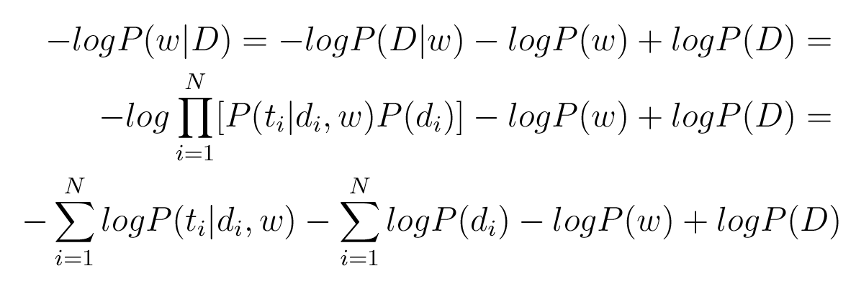
MAP/ML, NNs and supervised learning
The whole error (minus log posterior) can be written as:
Connectionist Computing COMP 30230

Slide 27
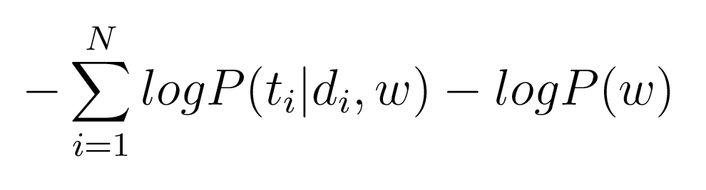
MAP/ML, NNs and supervised learning
The terms expressing the probability of the inputs don’t depend on the weights of the model.
What we are interested in minimising is:
Connectionist Computing COMP 30230

Slide 28
The prior
If we assume that P(w) has a Gaussian distribution, -log P(w) contributes a term proportional to –w² to the error. This is precisely weight decay.
Weight sharing can also be included into the prior.
Connectionist Computing COMP 30230

Slide 29
The likelihood: linear case
Let’s assume that we have a MLP with linear output.
We want to evaluate P(t|d,w). It is natural to express (d,w) as what the model does with d, i.e. the output of the model to d: y(d)=y. We can rewrite:
P(t|d,w) = P(t|y)
Connectionist Computing COMP 30230

Slide 30
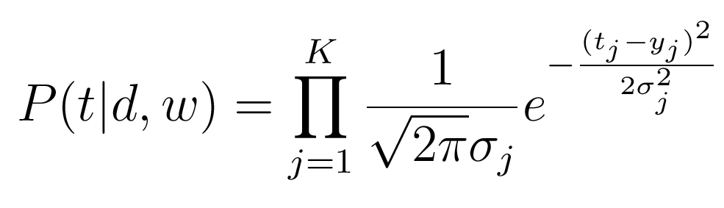
Linear output: Gaussian assumption
The “natural” distribution of t given y in the linear case is Gaussian.
Connectionist Computing COMP 30230

